Slide 1

Desing and Testing Problem 2 – Lesson 5 Views
Ángel Delgado Luna

Slide 2
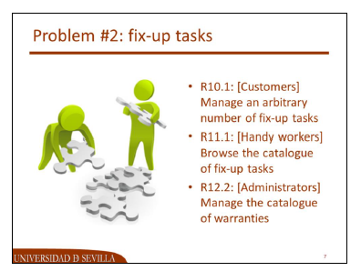
Index
Schema
UML Modeling
Requirement 10.1
Mockups
Code
Requirement 11.1
Mockups
Code
Requirement 12.2
Mockups
Codigo

Slide 3
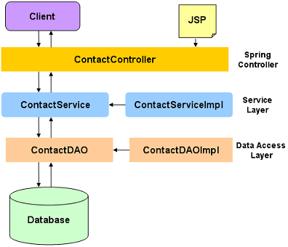
Schema

Slide 4
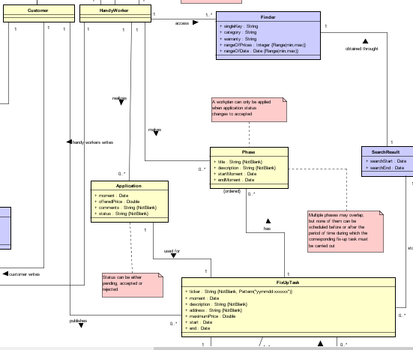
UML Modeling

Slide 5

Requirement 10.1 [Customers]
Manage an arbitrary number of fix-up tasks, which includes:
Listing (findAll())
Showing (findOne())
Creating (save(T e))
Updating (save(T e))
Deleting (delete (T e) or delete(id))

Slide 6
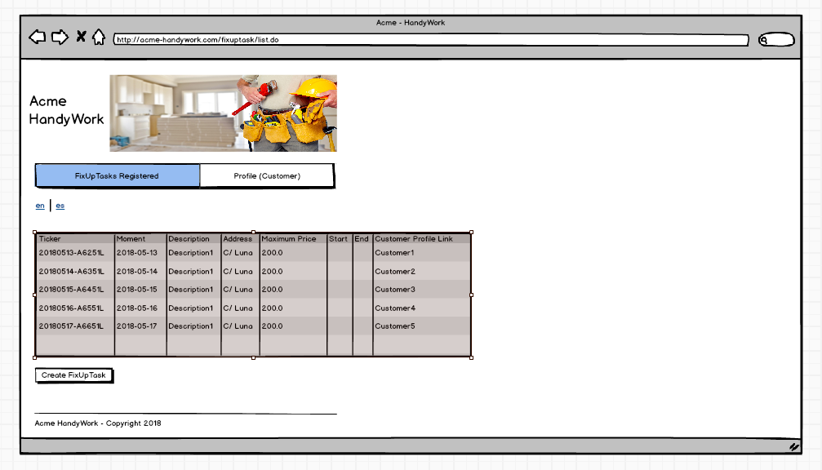

Slide 7
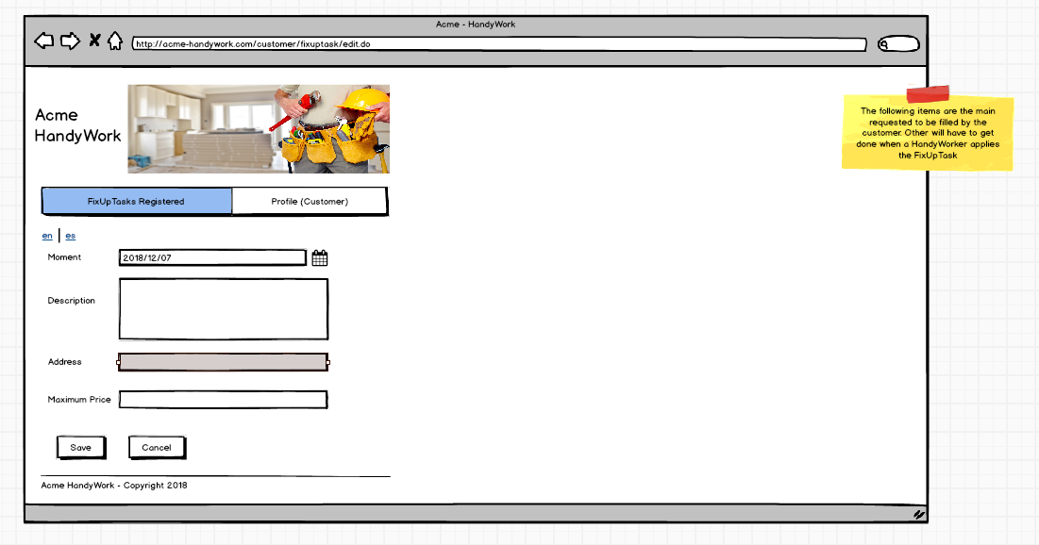

Slide 8
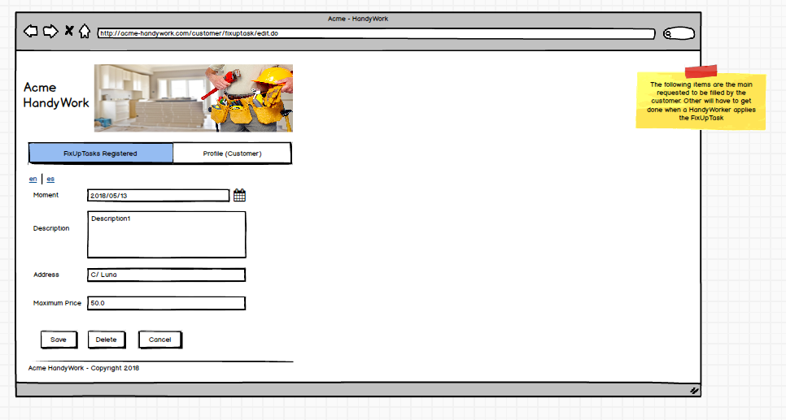

Slide 9

Requirement 11.1 [HandyWorkers]
Browse the catalogue of fix-up tasks and navigate to the profile of the corresponding customer, which includes his or her personal data plus his or her list of fix-up tasks.

Slide 10
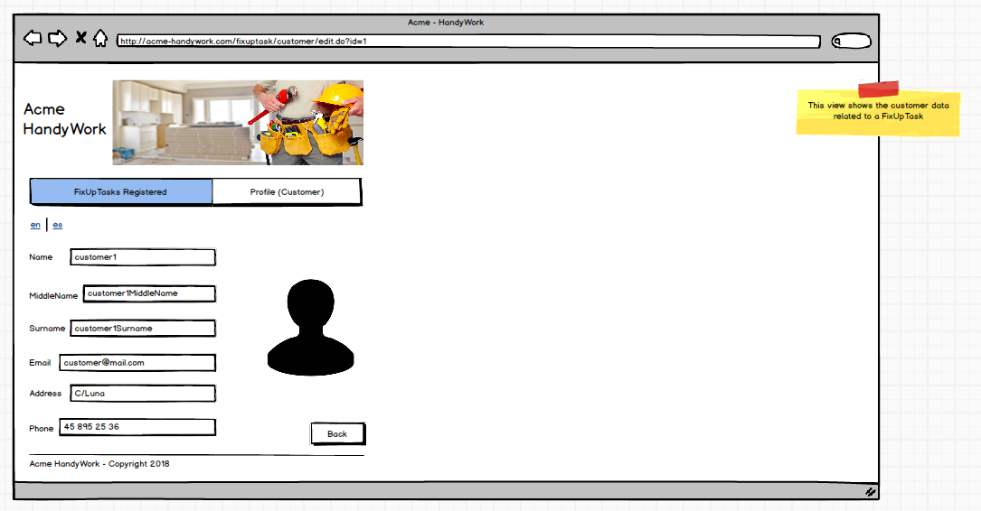

Slide 11

Requirement 12.2 [Administrators]
Manage the catalogue of warranties, which includes:
Listing (findAll())
Showing (findOne())
Creating (save(T e))
Updating (save(T e))
Deleting (delete (T e) or delete(id))
A warranty can be updated or deleted as long as it is saved in draft mode. Once it’s saved in final mode, it cannot be edited or deleted. Only warranties that are saved in final mode can be referenced by fix-up tasks.

Slide 12
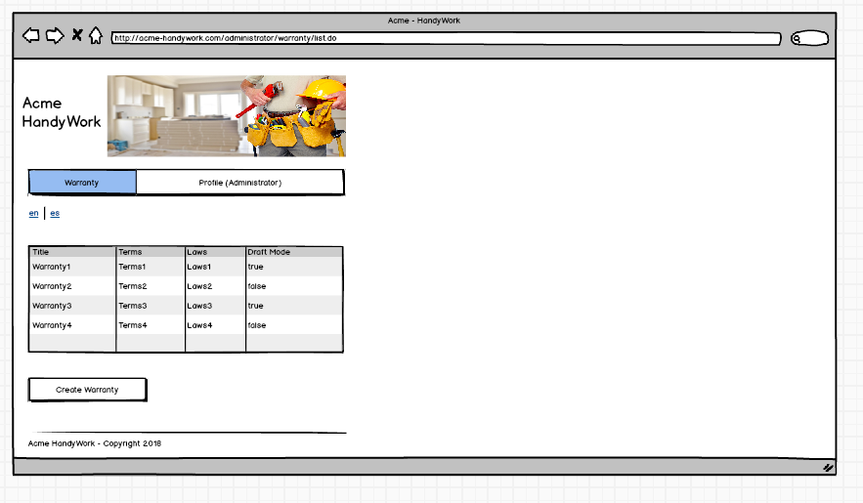

Slide 13
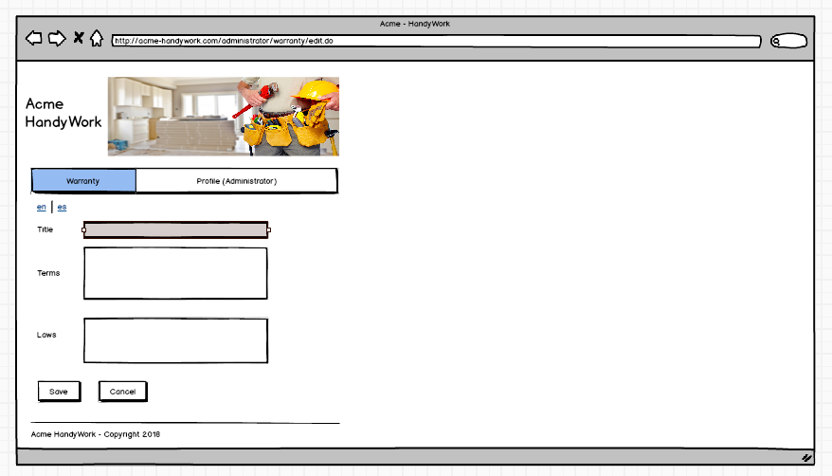

Slide 14
